Slide 1
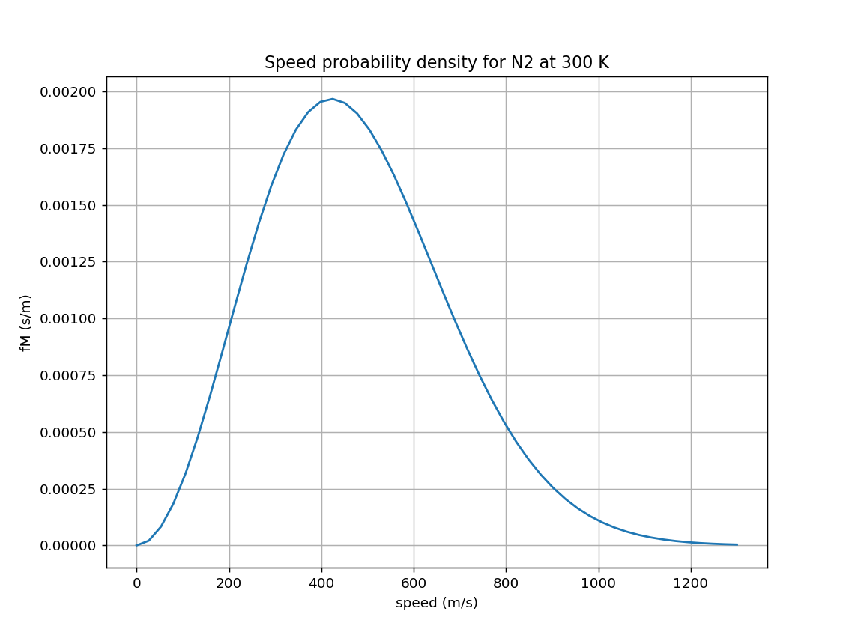
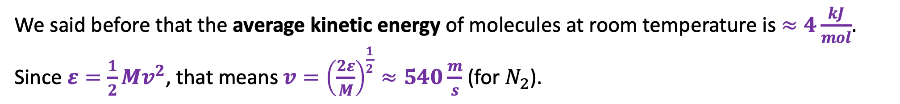
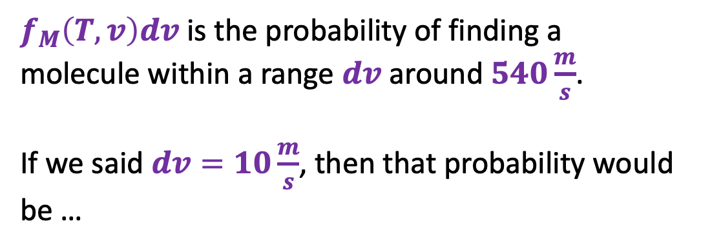

Transforming from one probability density to another
We said before that the average kinetic energy of molecules at room temperature is $≈4\frac{kJ}{mol}$. Since $ε=\frac{1}{2}Mv^{2}$, that means $v={\left(\frac{2ε}{M}\right)}^{\frac{1}{2}}≈540\frac{m}{s}$ (for $N_{2}$).
$f_{M}\left(T,v\right)$
$f_{M}\left(T,v\right)dv$ is the probability of finding a molecule within a range $dv$ around $540\frac{m}{s}$.
If we said $dv=10\frac{m}{s}$, then that probability would be …
$$dv$$

Slide 2
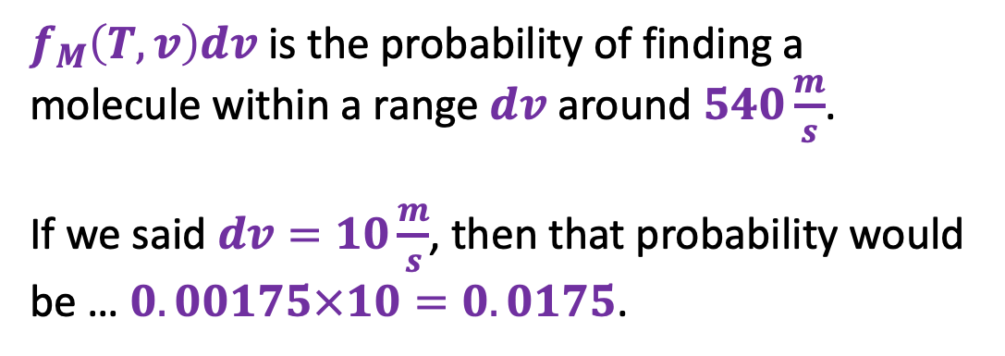
Transforming from one probability density to another
We said before that the average kinetic energy of molecules at room temperature is $≈4\frac{kJ}{mol}$. Since $ε=\frac{1}{2}Mv^{2}$, that means $v={\left(\frac{2ε}{M}\right)}^{\frac{1}{2}}≈540\frac{m}{s}$ (for $N_{2}$).
$f_{M}\left(T,v\right)$
$f_{M}\left(T,v\right)dv$ is the probability of finding a molecule within a range $dv$ around $540\frac{m}{s}$.
If we said $dv=10\frac{m}{s}$, then that probability would be … $0.00175×10=0.0175$.
$$dv$$

Slide 3
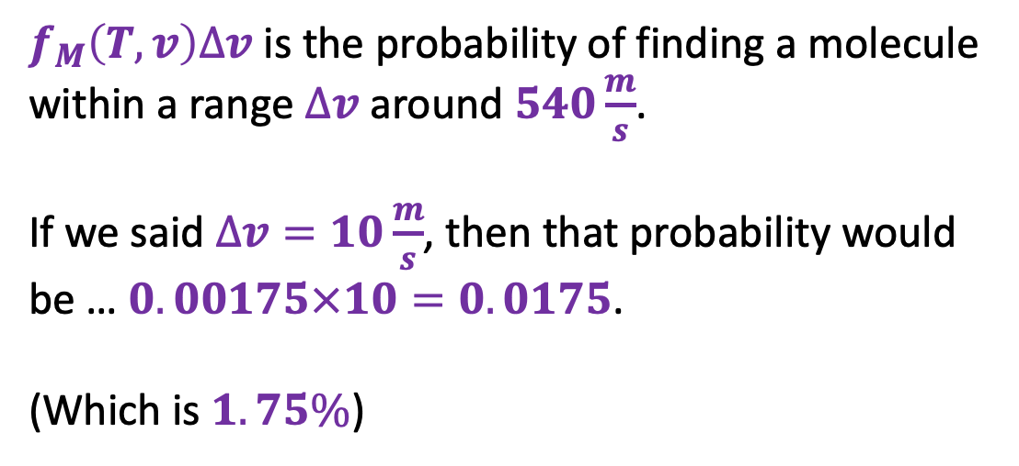
Transforming from one probability density to another
We said before that the average kinetic energy of molecules at room temperature is $≈4\frac{kJ}{mol}$. Since $ε=\frac{1}{2}Mv^{2}$, that means $v={\left(\frac{2ε}{M}\right)}^{\frac{1}{2}}≈540\frac{m}{s}$ (for $N_{2}$).
$f_{M}\left(T,v\right)$
$f_{M}\left(T,v\right)∆v$ is the probability of finding a molecule within a range $∆v$ around $540\frac{m}{s}$.
If we said $∆v=10\frac{m}{s}$, then that probability would be … $0.00175×10=0.0175$.
(Which is $1.75\%$)
$$∆v$$

Slide 4
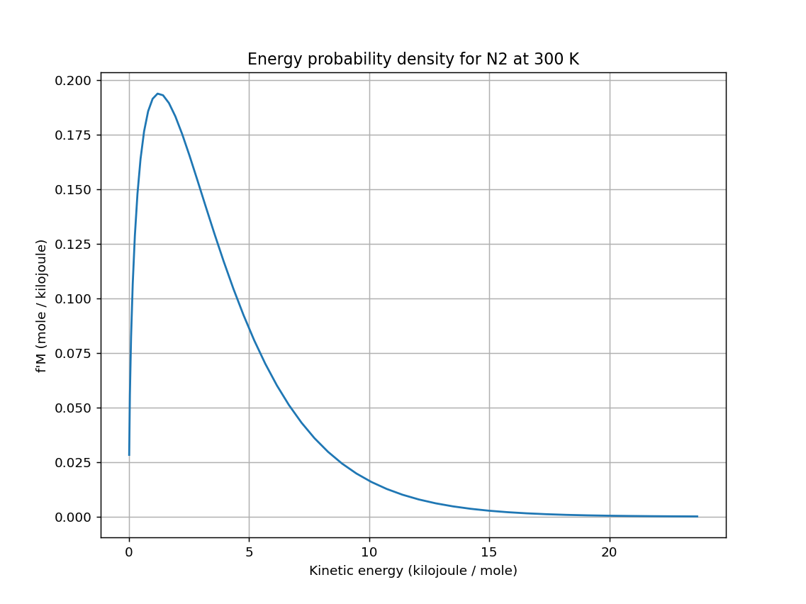

Transforming from one probability density to another
OK … what if we wanted to think about all this in terms of kinetic energy instead of speed?
$f_{M}\left(T,v\right)$
${f′}_{M}\left(T,ε\right)$
$$∆ε$$
$$∆v$$

Slide 5


Transforming from one probability density to another
OK … what if we wanted to think about all this in terms of kinetic energy instead of speed?
$${f′}_{M}\left(T,ε\right)∆ε=0.0175$$
$$f_{M}\left(T,v\right)∆v=0.0175$$
$f_{M}\left(T,v\right)$
${f′}_{M}\left(T,ε\right)$
$$∆ε$$
$$∆v$$

Slide 6


Transforming from one probability density to another
OK … what if we wanted to think about all this in terms of kinetic energy instead of speed?
Always equal to each other
$${f′}_{M}\left(T,ε\right)∆ε$$
$$f_{M}\left(T,v\right)∆v$$
$f_{M}\left(T,v\right)$
${f′}_{M}\left(T,ε\right)$
$$∆ε$$
$$∆v$$

Slide 7

Transforming from one probability density to another
OK … what if we wanted to think about all this in terms of kinetic energy instead of speed?
$${f′}_{M}\left(T,ε\right)∆ε=f_{M}\left(T,v\right)∆v$$
$f_{M}\left(T,v\right)$
${f′}_{M}\left(T,ε\right)$
$$∆ε$$
$$∆v$$

Slide 8
Transforming from one probability density to another
OK … what if we wanted to think about all this in terms of kinetic energy instead of speed?
${f′}_{M}\left(T,ε\right)∆ε=f_{M}\left(T,v\right)∆v$ => ${f′}_{M}\left(T,ε\right)=f_{M}\left(T,v\right)\frac{∆v}{∆ε}$
$f_{M}\left(T,v\right)$
${f′}_{M}\left(T,ε\right)$
$$∆ε$$
$$∆v$$

Slide 9
Transforming from one probability density to another
OK … what if we wanted to think about all this in terms of kinetic energy instead of speed?
${f′}_{M}\left(T,ε\right)∆ε=f_{M}\left(T,v\right)∆v$ => ${f′}_{M}\left(T,ε\right)=f_{M}\left(T,v\right)\frac{dv}{dε}$
$f_{M}\left(T,v\right)$
${f′}_{M}\left(T,ε\right)$
$$∆ε$$
$$∆v$$

Slide 10

Transforming from one probability density to another
OK … what if we wanted to think about all this in terms of kinetic energy instead of speed?
${f′}_{M}\left(T,ε\right)∆ε=f_{M}\left(T,v\right)∆v$ => ${f′}_{M}\left(T,ε\right)=f_{M}\left(T,v\right)\frac{dv}{dε}$
$f_{M}\left(T,v\right)$
${f′}_{M}\left(T,ε\right)$
$$∆ε$$
$$∆v$$
(and $ε=\frac{1}{2}Mv^{2}$ can get us $\frac{dv}{dε}$)

